Slide 1



Improving Autism Spectrum Disorders in children through Health Informatics

Slide 2

Overview
INTRODUCTION
BACKGROUND
HEALTH INFORMATICS (HI) INTERVENTIONS –
SCREENING TOOLS
ELECTRONIC HEALTH RECORD (EHR)
TELEHEALTH
WEARABLES
CONCLUSION/RECOMMENDATION

Slide 3



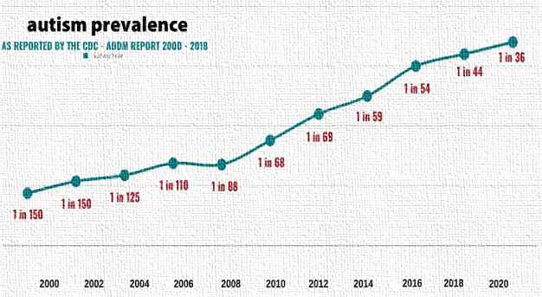
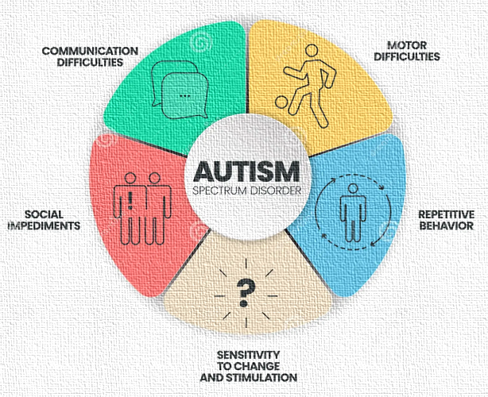
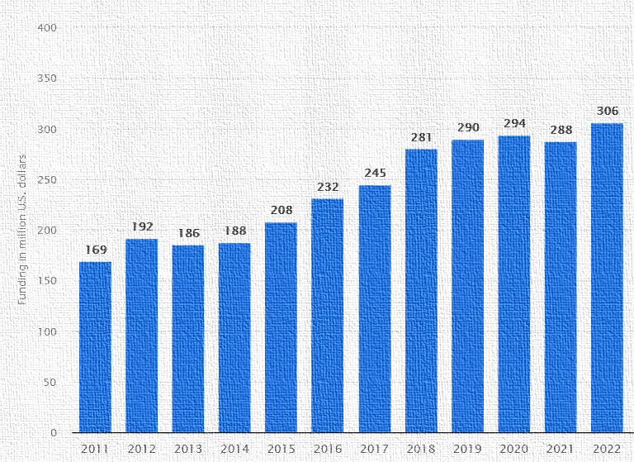
Introduction
Why is there a need to address Autism Spectrum Disorders (ASD) ?
Autism is a multifaceted neurological and developmental condition
It is characterized by impairments in social communication and the manifestation of restricted interests and repetitive behaviors
Total Autism Funding By NIH from 2011-2022

Slide 4

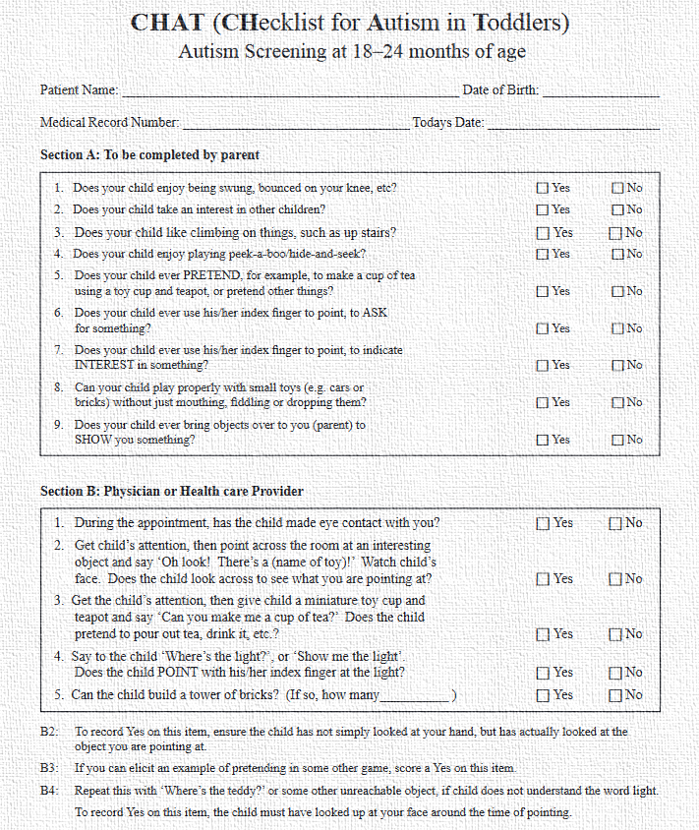
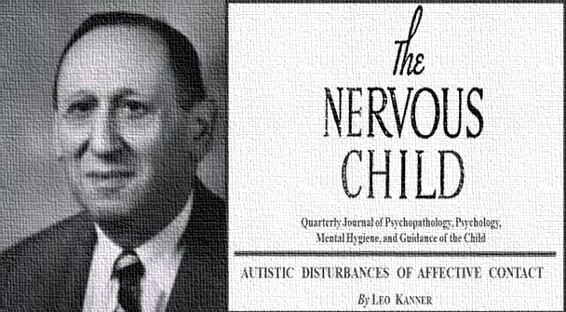
Background
2015
SCREENING TOOLS
2016
ELECTRONIC HEALTH RECORDS
1943, Leo Kanner:
Was the first to delineate autism as a syndrome in a study conducted at Johns Hopkins University
2015
TELEHEALTH
Early 1990s, Checklist for Autism in Toddlers (CHAT):
Earliest validated screening tests for autism
2017 -> 2021 -> !! WEARABLES

Slide 5

1. Screening Tools
HI Interventions
CHAT – Early 1990s
Modified CHAT (M-CHAT) - 2001
M-CHAT-R/F - 2009
M-CHAT-R/F Digitization - 2015
M-CHAT-R/F
1. 20 yes-or-no questions 2. 20 items that evaluate behaviors often linked with autism 3. Scoring: 0-2 very low ASD risk 3-7 for moderate risk 8-20 for high ASD risk 4. PCPs preferred screening kids during their 18 and 24-month routine visits using the digitized version
Q-CHAT
1. The Quantitative Checklist for Autism in Toddlers (Q-CHAT) Introduced ordinal responses (how much/often) 2. Comprises 25 items relating to a child's development and reflective of autistic behaviors 3. Employs a Likert scale ranging from 0 to 4 for each item. The cumulative Q-CHAT score spans from 0 to 100
Machine Learning methods tested on Q-CHAT data
Autism detection rates >90% using 14 items
Potential to
enhance
precision

Slide 6


2. Electronic Health Records
2016 -
Automated algorithm for identifying a cohort of ASD patients from EHR developed, evaluated, and validated
20,000 patients investigated, largest ASD cohort assembled thus far
Patterns of medical comorbidities that co-occur with ASD examined
- Premature
birth,
- Low birth
weight,
- Perinatal
complications
2023
EHR-based autism detection occurs much earlier (at 30 days of age) and is completely passive, no additional data collection.
This method identified 45.5% (approximately half) of children with autism at 30 days while upholding a high specificity of 90.0%
- Hyperbili
rubinemia
- Respiratory
infections
- Diagnostic
codes
Issues related to crying, feeding, and sleeping
2021 - Predictive models utilizing claims data based solely on prior diagnosis codes could yield valuable autism-related insights by 100 weeks of age

Slide 7


3. Telehealth
Synchronous
Live video-conferencing
Asynchronous
Uploading videos to online portal
Telehealth
Application of telehealth
Diagnosis
NODA Capture
NODA Connect
Assessment
TELE-ASD-PEDS
Employs ML algorithm
(Identifies 12 most age-predictive and communication-appropriate activities, offering support to clinicians)
(The Naturalistic Observation Diagnostic Assessment)
(Telemedicine-based Autism Spectrum Disorder Evaluation Tool for Toddlers and Young Children)

Slide 8
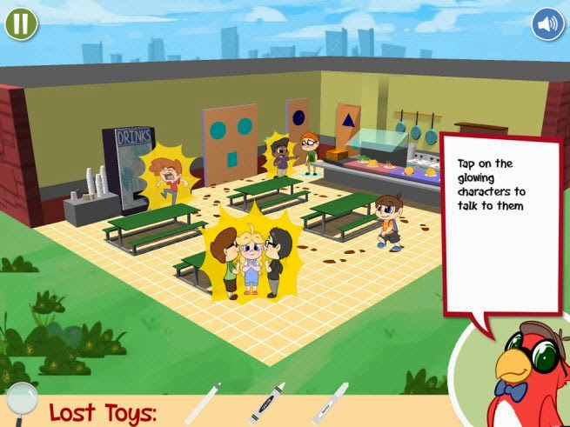
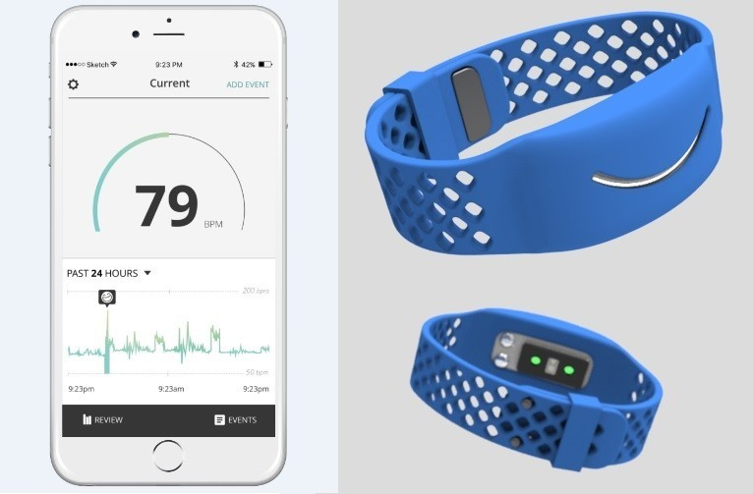
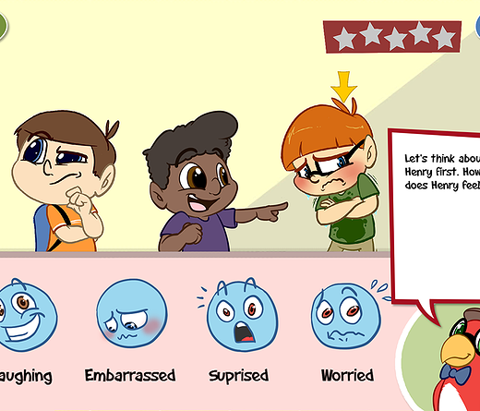
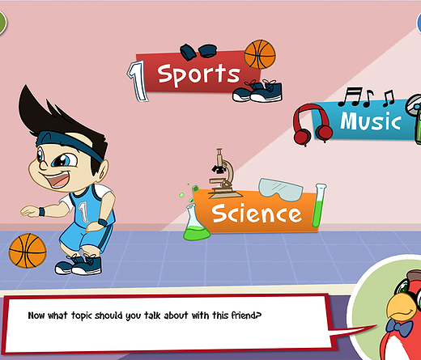
4. Wearables / Internet of Things (IOT)
- Wearables assess the physiological and behavioral aspects of individuals with ASD
- Of particular interest is the autonomic nervous system (ANS), which plays a vital role in regulating blood pressure, heart rate, respiratory rate, body temperature and sweat production, often showing atypical patterns in individuals with autism. Wearable devices can measure these physiological markers indicative of ANS activity providing valuable insights into physiological responses that are not easily observed otherwise
- Ecological validity ; Repeated assessment ; Mitigation of reactivity

Slide 9
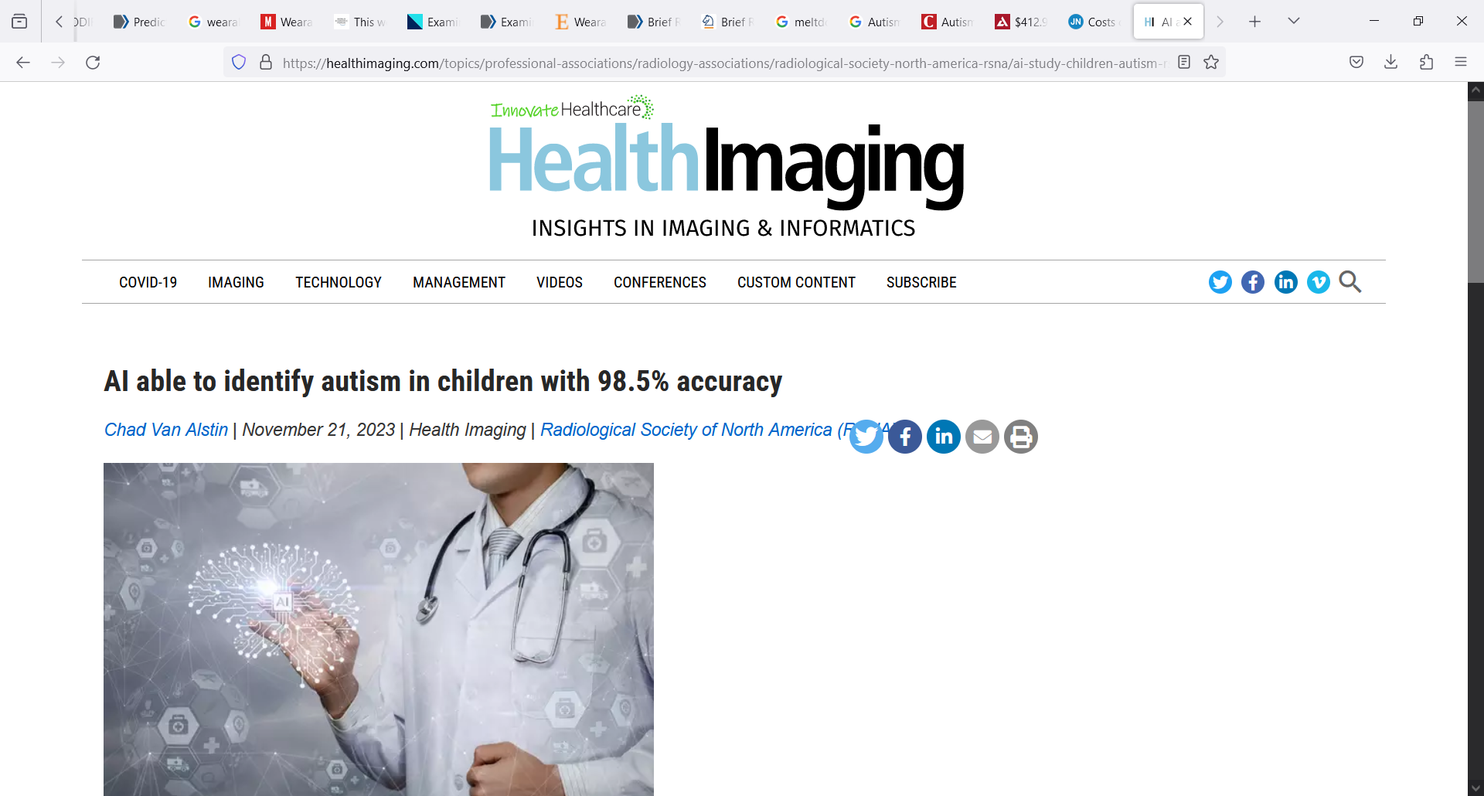
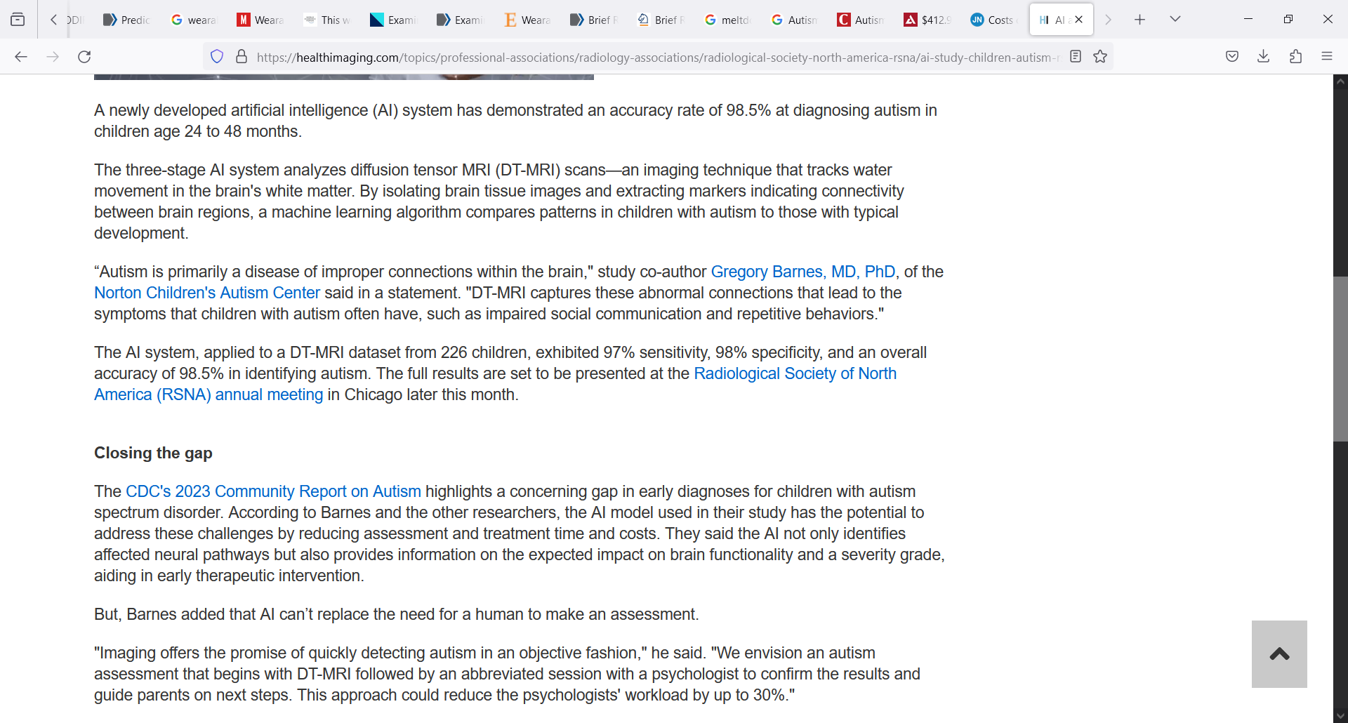
Conclusion
F
U
T
U
R
E
- Health informatics interventions have significantly advanced ASD identification and treatment.
- Screening tools ease identification
- Telemedicine reduces delays between parents expressing concerns and obtaining an official assessment and diagnosis of ASD
- EHR data holds substantial value
- Wearable sensors facilitate ecological validity, repeated assessment and mitigation of reactivity
Limitations
Recommendations
- Small sample sizes
- Study participants’
attrition like convincing
families about the necessity
of diagnostic evaluations,
or, parents declining
participation, resulting in
an overrepresentation of
parents with higher levels of education in the sample
- Combination of these
interventions to further
increase the efficiency of
individual tools
- Further investment into
wearables

Slide 10
Questions & answers
Thank you !
By Kaustubh Dilip Pachpande
Bouvé College of Health Sciences, Northeastern University
HINF 5101: Intro to Health Informatics

Slide 11
References
References
Black, M. H., Milbourn, B., Chen, N. T. M., McGarry, S., Wali, F., Ho, A. S. V., Lee, M., Bölte, S., Falkmer, T., & Girdler, S. (2020). The use of wearable technology to measure and support abilities, disabilities and functional skills in autistic youth: a scoping review. Scand J Child Adolesc Psychiatr Psychol, 8, 48-69. https://doi.org/10.21307/sjcapp-2020-006
Campbell, K., Carpenter, K. L. H., Espinosa, S., Hashemi, J., Qiu, Q., Tepper, M., Calderbank, R., Sapiro, G., Egger, H. L., Baker, J. P., & Dawson, G. (2017). Use of a Digital Modified Checklist for Autism in Toddlers - Revised with Follow-up to Improve Quality of Screening for Autism. The Journal of pediatrics, 183, 133–139.e1. https://doi.org/10.1016/j.jpeds.2017.01.021
Engelhard, M. M., Henao, R., Berchuck, S. I., Chen, J., Eichner, B., Herkert, D., Kollins, S. H., Olson, A., Perrin, E. M., Rogers, U., Sullivan, C., Zhu, Y., Sapiro, G., & Dawson, G. (2023). Predictive Value of Early Autism Detection Models Based on Electronic Health Record Data Collected Before Age 1 Year. JAMA Netw Open, 6(2), e2254303. https://doi.org/10.1001/jamanetworkopen.2022.54303
Kientz, J. A., Goodwin, M. S., Hayes, G. R., & Abowd, G. D. (2014b). Sensor-Based and Wearable. In Interactive Technologies for Autism (pp. 75-85). Springer International Publishing. https://doi.org/10.1007/978-3-031-01595-3_8
Lingren, T., Chen, P., Bochenek, J., Doshi-Velez, F., Manning-Courtney, P., Bickel, J., Wildenger Welchons, L., Reinhold, J., Bing, N., Ni, Y., Barbaresi, W., Mentch, F., Basford, M., Denny, J., Vazquez, L., Perry, C., Namjou, B., Qiu, H., Connolly, J., . . . Savova, G. (2016). Electronic Health Record Based Algorithm to Identify Patients with Autism Spectrum Disorder. PLoS One, 11(7), e0159621. https://doi.org/10.1371/journal.pone.0159621
List the resources you used for your research:
Source #1
Source #2
Source #3

Slide 12
References
References
Liu, M., & Ma, Z. (2022). A systematic review of telehealth screening, assessment, and diagnosis of autism spectrum disorder. Child Adolesc Psychiatry Ment Health, 16(1), 79. https://doi.org/10.1186/s13034-022-00514-6
Onishchenko, D., Huang, Y., van Horne, J., Smith, P. J., Msall, M. E., & Chattopadhyay, I. (2021). Reduced false positives in autism screening via digital biomarkers inferred from deep comorbidity patterns. Science Advances, 7(41), eabf0354. https://doi.org/doi:10.1126/sciadv.abf0354
Riva, V., Villa, L., Fulceri, F., Arduino, G. M., Leonti, G., Valeri, G., Casula, L., Zoccante, L., Puttini, E., Sogos, C., Presicce, M., Bentenuto, A., Apicella, F., Molteni, M., & Scattoni, M. L. (2023). The teleNIDA: Early Screening of Autism Spectrum Disorder Through a Novel Telehealth Approach. J Autism Dev Disord, 1-11. https://doi.org/10.1007/s10803-023-05927-6
Ruel, A., Chiarella, S. S., Crivello, C., & Poulin-Dubois, D. (2021). Concurrent Validity of the Modified Checklist for Autism in Toddlers (M-CHAT): Socio-cognitive and Verbal Skills in 18-Month-Old Infants. J Autism Dev Disord, 51(3), 933-949. https://doi.org/10.1007/s10803-020-04379-6
Sturner, R., Howard, B., Bergmann, P., Attar, S., Stewart-Artz, L., Bet, K., Allison, C., & Baron-Cohen, S. (2022). Autism screening at 18 months of age: a comparison of the Q-CHAT-10 and M-CHAT screeners. Mol Autism, 13(1), 2. https://doi.org/10.1186/s13229-021-00480-4
Sturner, R., Howard, B., Bergmann, P., Morrel, T., Andon, L., Marks, D., Rao, P., & Landa, R. (2016). Autism Screening With Online Decision Support by Primary Care Pediatricians Aided by M-CHAT/F. Pediatrics, 138(3). https://doi.org/10.1542/peds.2015-3036
List the resources you used for your research:
Source #1
Source #2
Source #3

